Slide 1


Version Control With GIT
MINI PROJECT

Slide 2

Contents
Mini Project Tasks.
Implementation of Given Tasks.

Slide 3

Mini Project Tasks
Create a repository VEHICLE with contain Param.txt – Initial empty file
Commit 1: Base param – master branch
Commit 2: Fourth Stage PS4 – Branch: PS4
Commit 3: Third Stage PS3 – Branch: PS3
Commit 4: Second Stage PS2 – Branch: PS2
Commit 5: First Stage PS1 – Branch: PS1
Ram committed all the stages of the launch vehicle from fourth to first in sequence in Param.txt and pushed to VEHICLE
Now Sam looks into parameter file of the vehicle and proposed forecasted speed of the vehicle. Sam’s repository is SPEED with file Param.txt (launch vehicle parameters) and vehicle_speed.txt

Slide 4
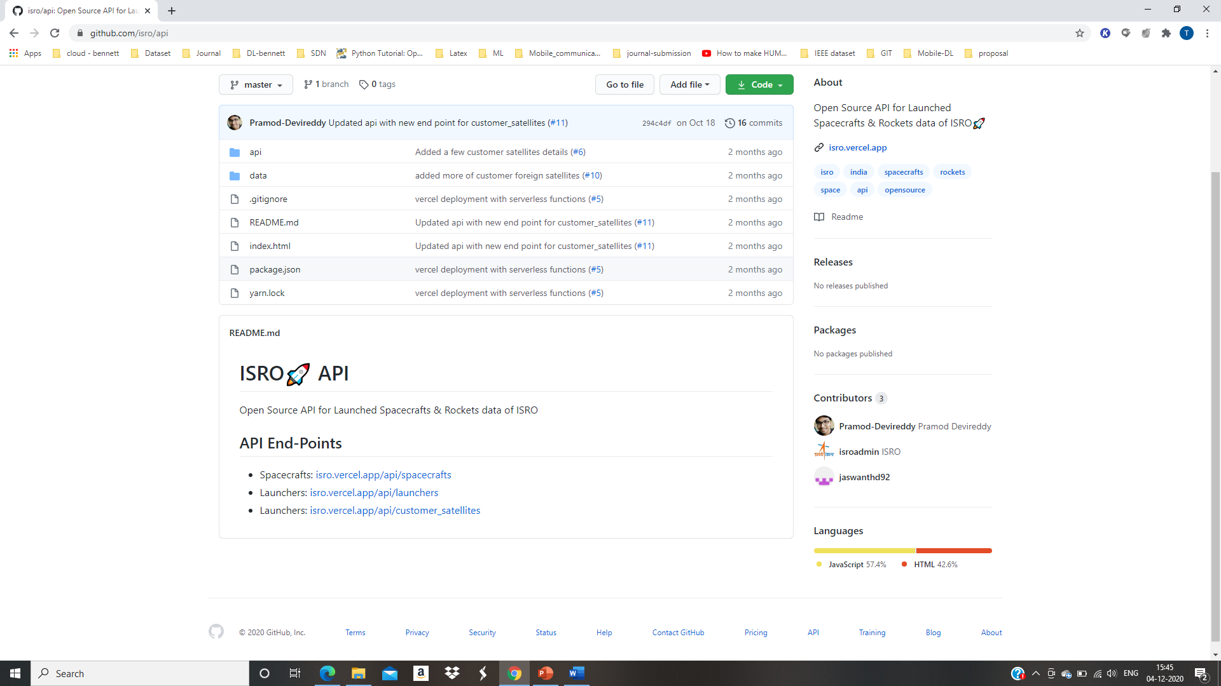
Mini Project Tasks
For speed prediction, Sam noticed the Max. Thrust in PS3 stage has to modified for proper working of launch vehicle. Max. Thrust: 252 kN and made a pull request to Ram and changes are updated.
Speed parameter is also included in Param.txt by Sam. Updation of speed is the latest commit, which head should refer. (Rebase)
Include MIT License.
Create README file with the following contents

Slide 5
Mini Project Tasks
Give the graphical view of the commits made in both repository (provide screen shots)
Create a file (vision.txt). This file should be pushed to both repository with single PUSH. (Configuration file)
Create a git ignore file (.docx) which contain your name with affiliation details

Slide 6
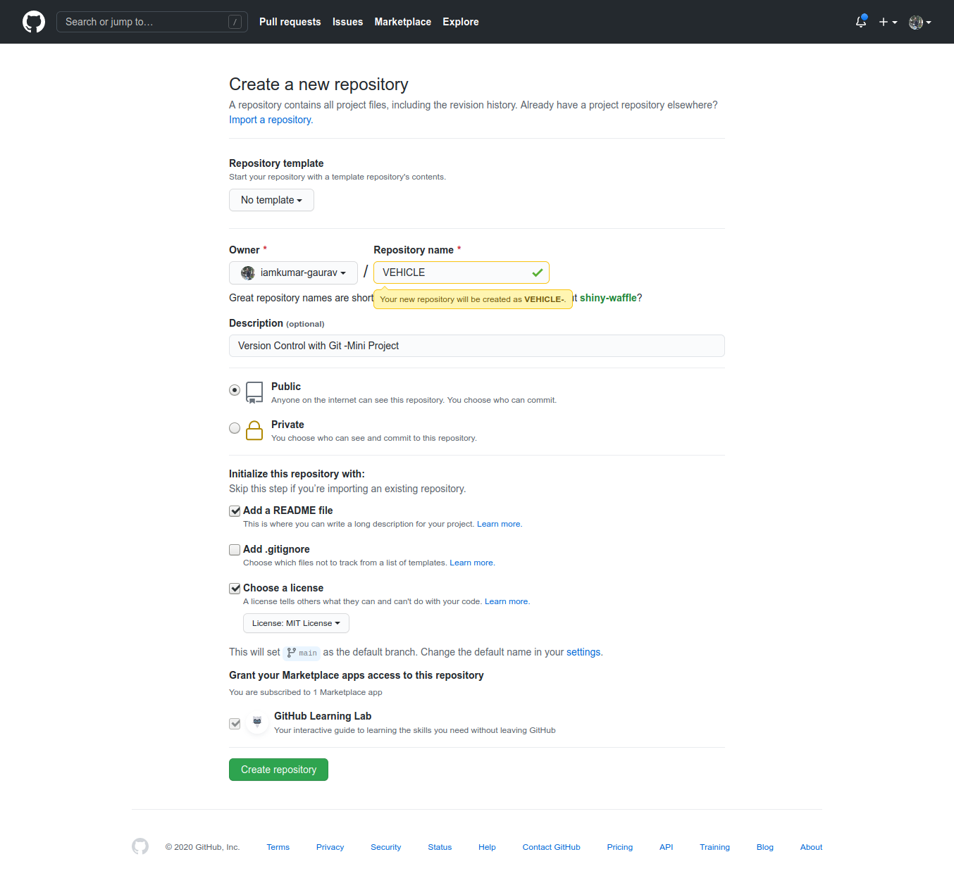

Implementation of Given Tasks.
From 1-7

Slide 7
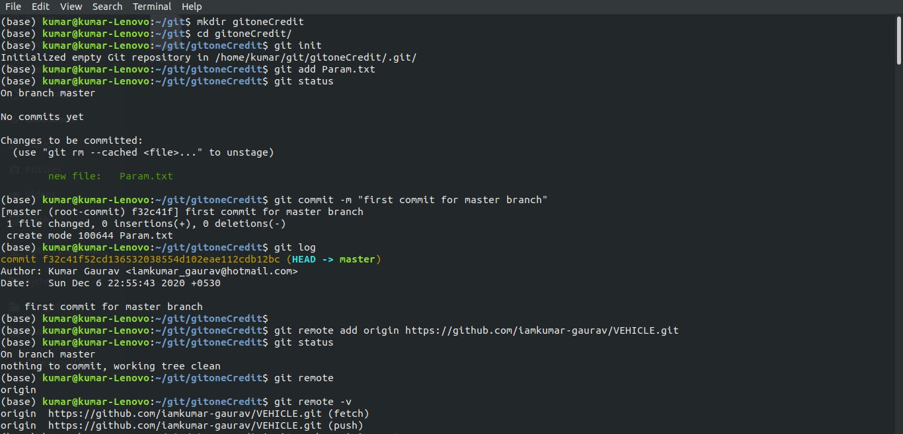
Implementation of Given Tasks.
From 1-7

Slide 8
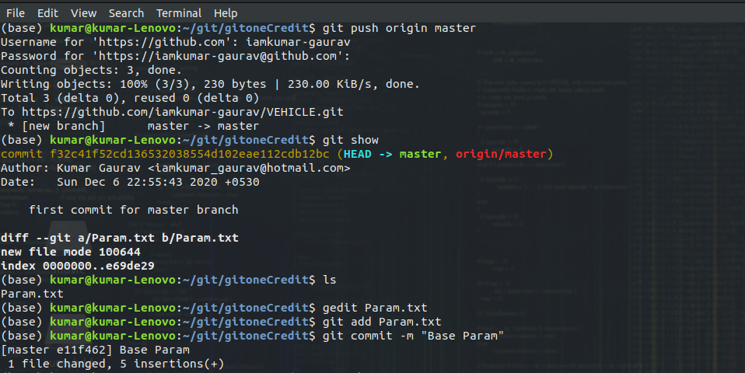
Implementation of Given Tasks.
From 1-7

Slide 9
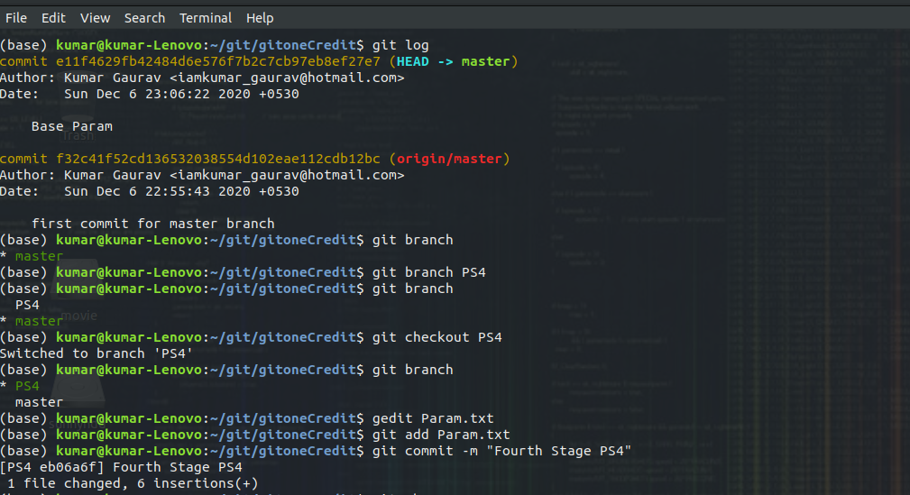
Implementation of Given Tasks.
From 1-7

Slide 10
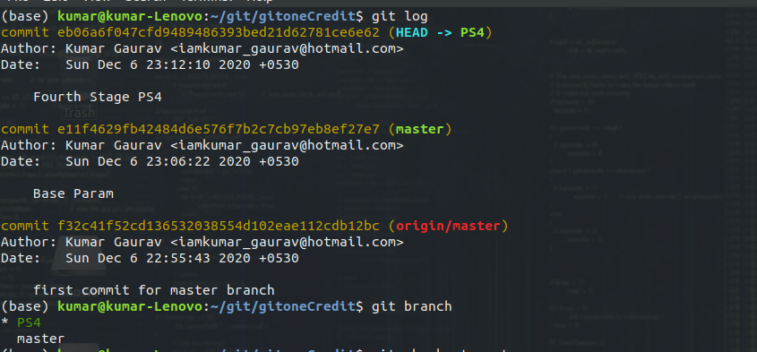
Implementation of Given Tasks.
From 1-7

Slide 11
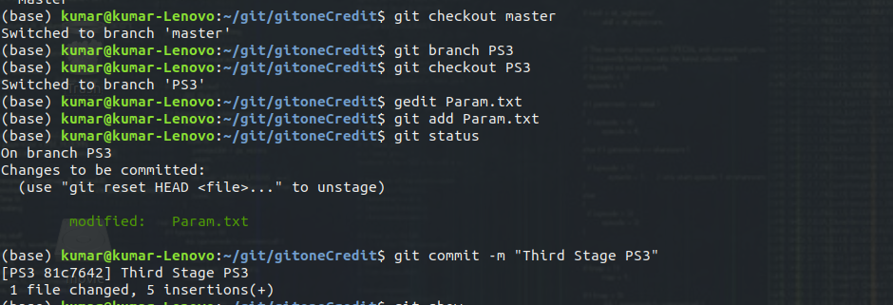
Implementation of Given Tasks.
From 1-7

Slide 12
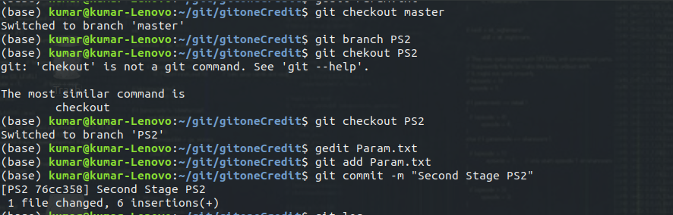
Implementation of Given Tasks.
From 1-7

Slide 13
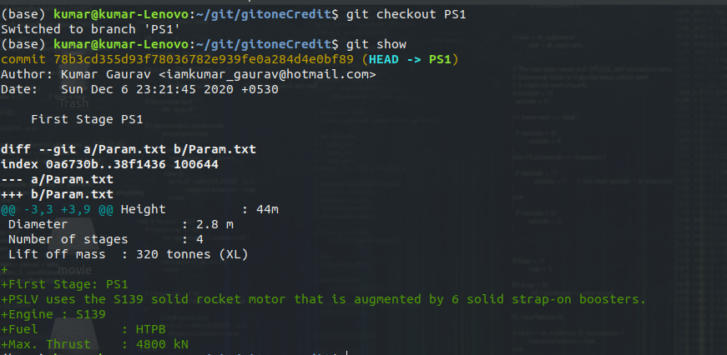
Implementation of Given Tasks.
From 1-7

Slide 14
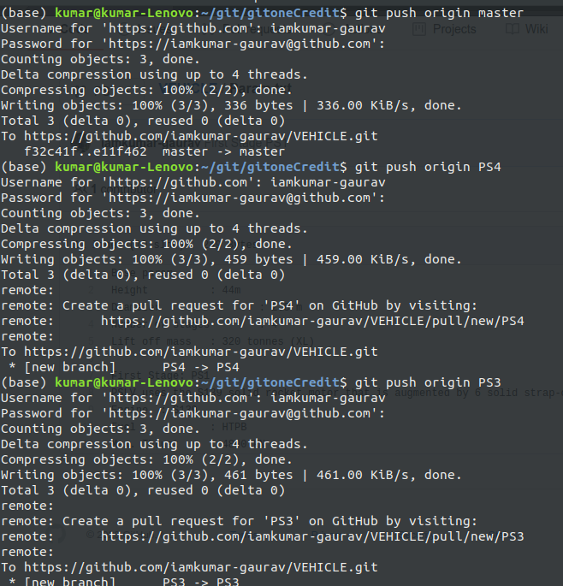
Implementation of Given Tasks.

Slide 15
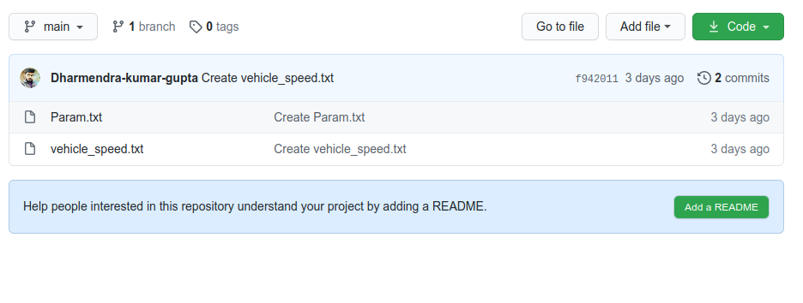
8.Sam Repo
Consider this as SAM Repository

Slide 16
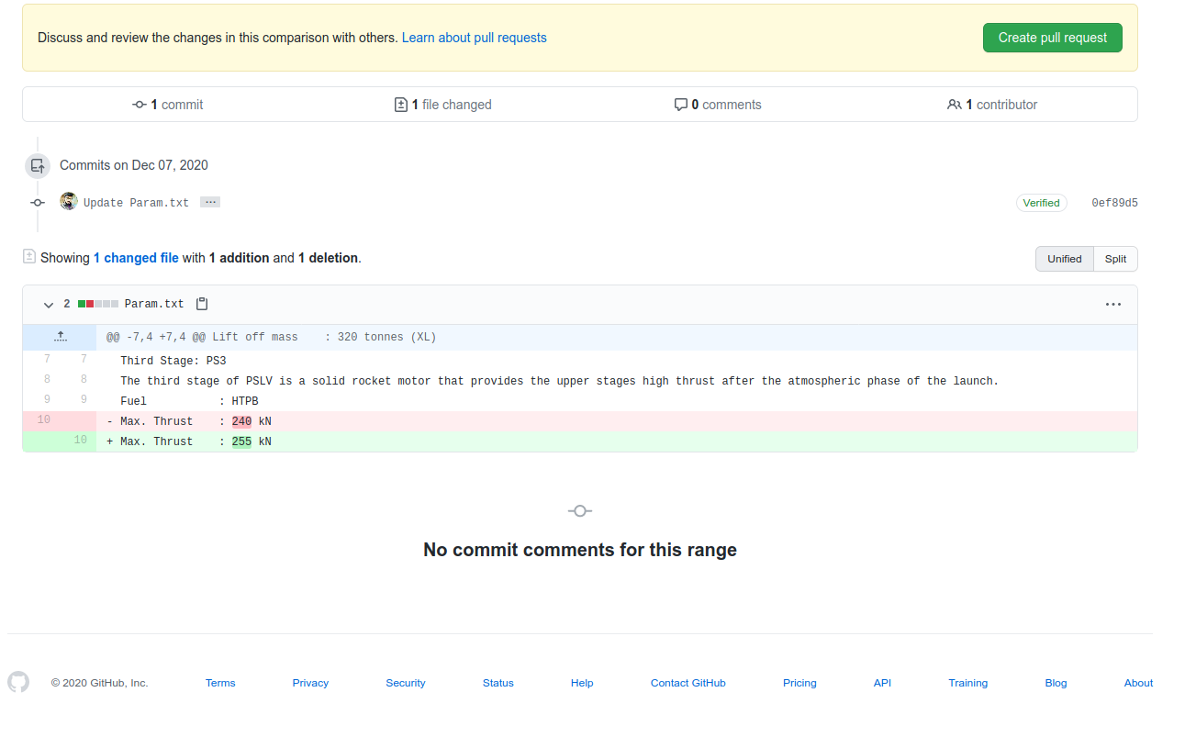
9.Sam Repo

Slide 17
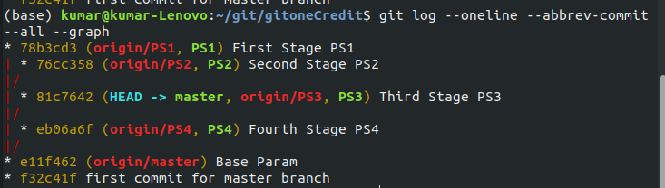
10.Rebase

Slide 18
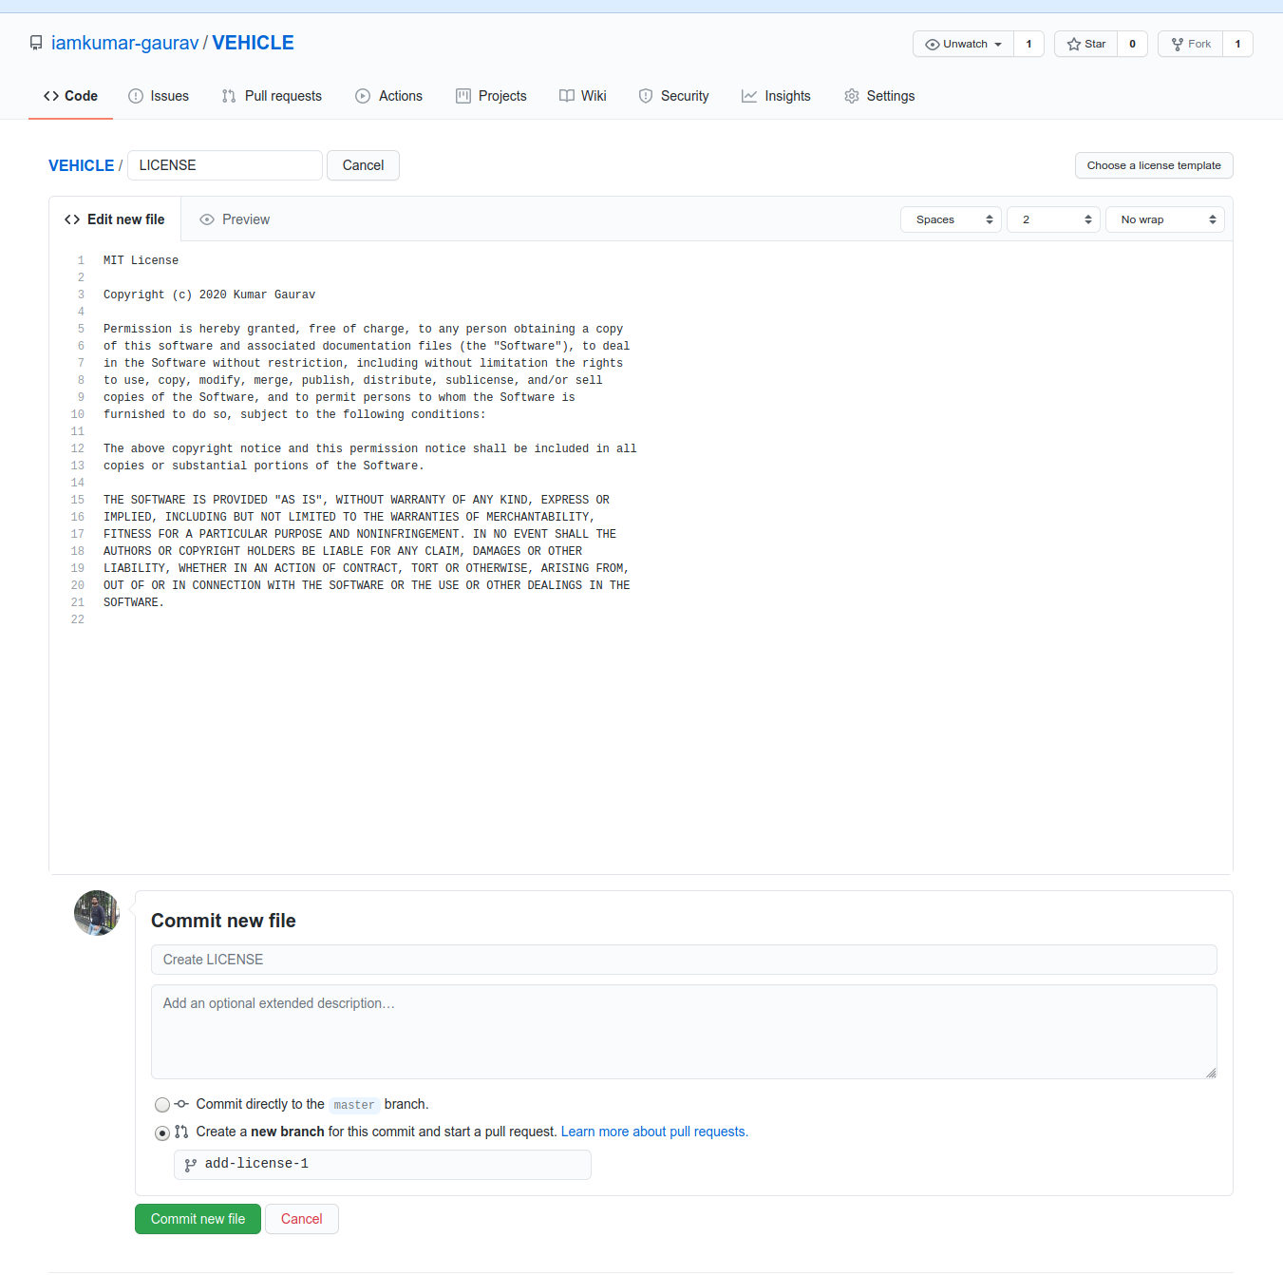
11.Include MIT License

Slide 19
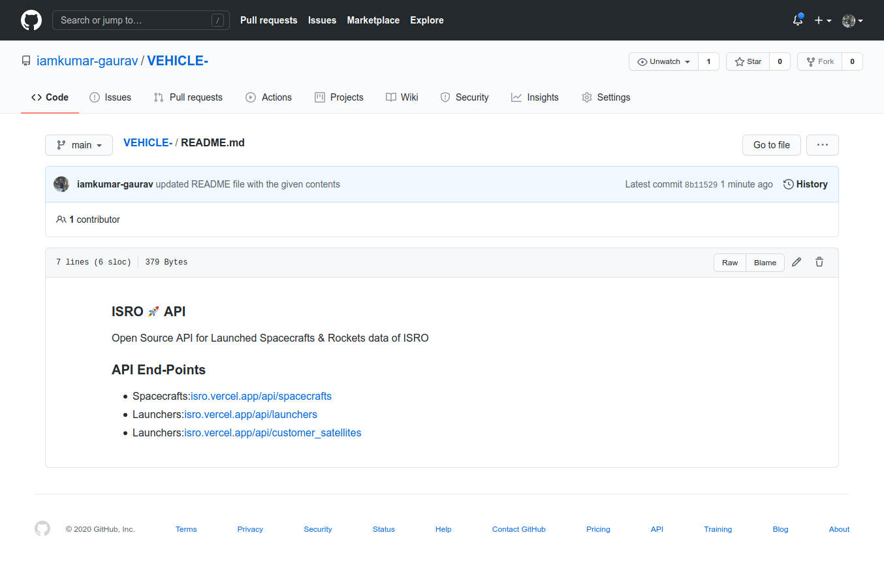
12.Create README file

Slide 20
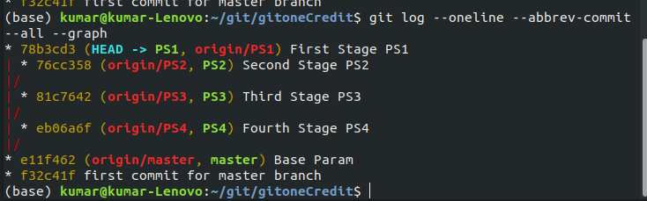
13.Graphical Repersentation

Slide 21
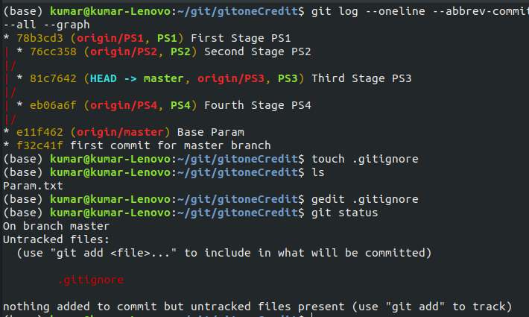
15.Git ignore file

Slide 22


